Slide 1



Facial expression
recognotion in real time
Team ID - CU_CP_Team_9148
salandri vaishnavi
damanapelly ashritha
Under the mentorship of, Dwaraka sir

Slide 2

Project Objectives
Problem Statement
Project Overview – Introduction
End Users
Wow Factor in Project
Modelling/Block Diagram/Flow of Project
Result/outcomes
Conclusion
Future Perspective

Slide 3
Problem Statement Facial expression recognition (FER) is a crucial aspect of human-computer interaction ,emotion analysis ,and surveillance applications. The challenge lies in accurately detecting and classifying facial expressions from live video feeds under varying conditions such as different lighting ,angles, occlusions ,and diverse facial features . Traditional methods struggling with real-time performance and accuracy due to computational constraints and variations. **The goal of this project is to develop a real-time facial expression recognition system that can accurately detect classify human emotions from live video stream of camera feeds.**

Slide 4
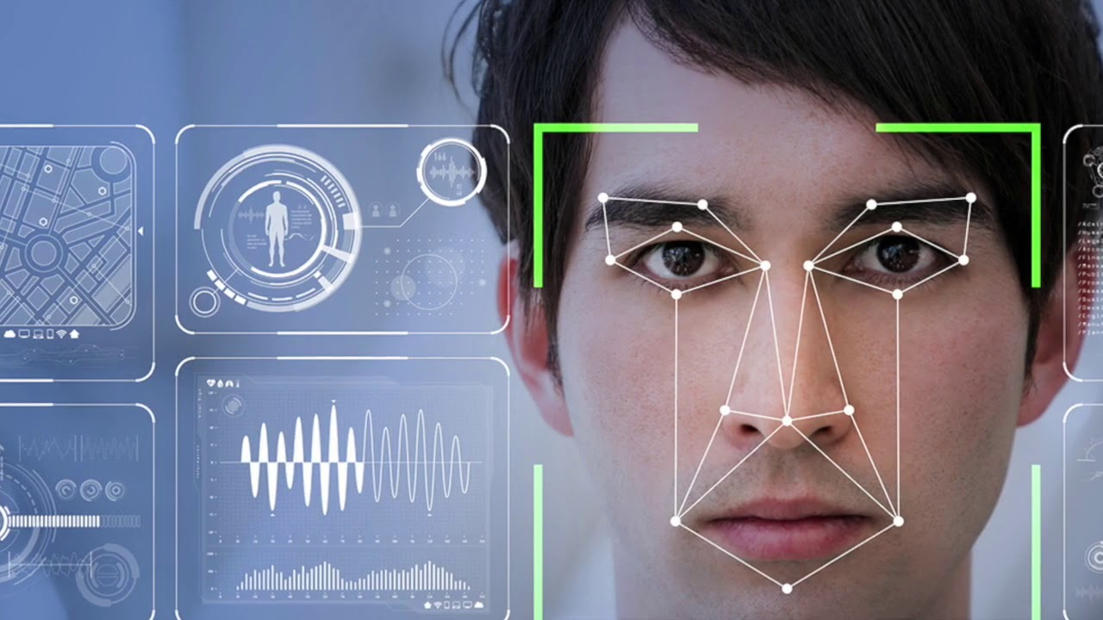
Project overview- Introduction
Facial expression recognition is a technolgy that detects and interpretes human facial expressions.
It classifies emotions such as happiness, sadness,
anger, surprice, fear and neutrality by analyzing facial features like eyes, eyebrows, mouth movements.
Detects and track faces in real time.
It detects the faces from live video streams.
It provide real time and low latency performance

Slide 5
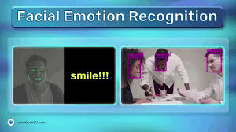
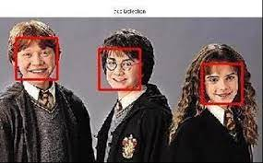
End Users —Educators —Employers —Developers —Marketers —Customer service agents —Gamers and ETC…..

Slide 6
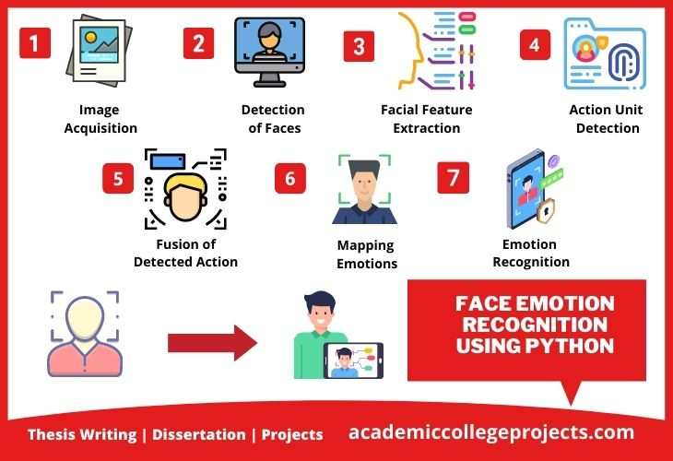
Wow Factor in solution
--real time processing
--multi person analysis
--real-time alerts and actions
--3D facial expression analysis

Slide 7
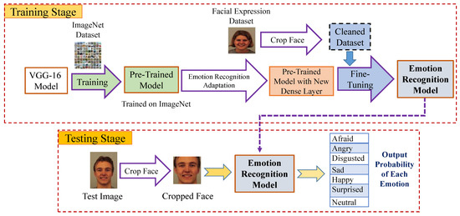
Modelling

Slide 8
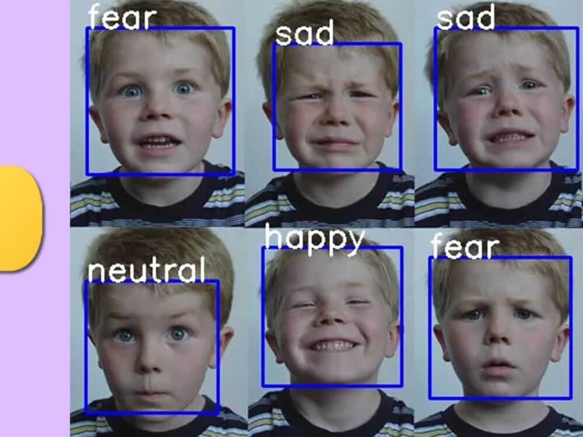
Result / Outcomes
real-time facial expression recognition system is typically a classification of the detected facial expression .
IT can analyzes whether the particular person is cry, smile, sad, happy, neutral,
angry and etc
Based on that facial expression it can display

Slide 9
conclusion
facial expresion recognition in real time is a powerful technology. this system can
accurately classify human emotions based on facial expression.
This projects demonstrates the effectiveness of deep learning models in recognizing
emotions such as happy,sadness, fear,anger, surprice,neutral..
The combination of pree- trained models and real time video processing enables efficient and responsive reconition .
Making it suitable for various applications including human computer interaction
mental health monitoring, and security systems.

Slide 10
Future Perspective future of real-time facial expression recognition is promising , --Automation safety --workplace productivity and employee well being ---Improved accuracy

Slide 11
Thank you...!

